Slide 1
Java
Constructors

Slide 2
Java – Default Constructors
A constructor is a special method in a class, used to initialize the object’s fields.
The name of the constructor is same as that of the class name.
Whenever a new object of its class is created, a constructor is invoked.
Every class has a constructor.
Even if it is not defined, compiler would create a one implicitly.
Constructors do not have return type.
If no constructor is defined, the default constructor would initialize the instance variables to their default values (0 for numeric values, false for boolean type and null for reference types).

Slide 3
Example: Java – Default Constructors
class Box
{
double height, width;
Box() //constructor
{
height = 5;
width = 5;
}
}
class BoxExample
{
public static void main(String args[])
{
Box b = new Box(); //invokes the constructor
}
}

Slide 4
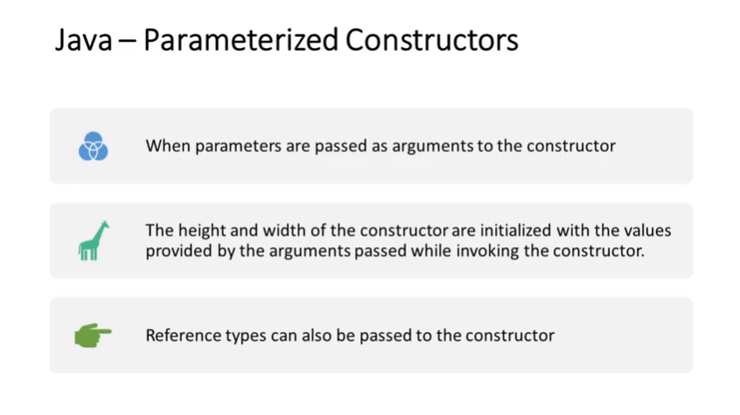

Slide 5
Java – Parameterized Constructors
When parameters are passed as arguments to the constructor
Example:
class Box
{
double height, width;
Box(double h, double w) //parameterized constructor
{
height = h;
width = w;
}
}
class BoxExample
{
public static void main(String args[])
{
Box b = new Box(3.0,5.0); //invokes the constructor
}
}
The height and width of the Box are initialized with the values provided by the arguments passed while invoking the constructor.
Reference types can also be passed to the constructor

